Slide 1
AGENDA
SRM - Ramapuram Institute of Science and Technology

Slide 2
Self-Introduction.
Career focus.
Current trends in the market.
How to get ready for placements?
Acing an interview.
Q&A.
Surprise.

Slide 3
Career Focus
Ask yourself these questions daily..
Where would you like to be 5-10 years down the line?
What are your strengths?
What is your area of specialization?
Why should you go through this particular course?
What goals have you set? Does it lead to a milestone?
What do you need to do to achieve your goals?
Once you hit your goal, do you stop?

Slide 4
Career Focus
Trust yourself
Don’t be afraid to fail
Ignore the naysayers
Work like hell
Give something back
Who stated the above rules of success?

Slide 5
Career Focus
How can you be good at what you do?
Spend more time
Practice more harder
Use the three levels of remembrance
Study the background
Understand its importance in the market
Know the advantages and disadvantages
Compare your knowledge with real life scenarios

Slide 6
Current Trends In The Market
There was a time when many companies recruited graduates for domain specific work. When I say domain specific work, I mean that they used to recruit graduates who are good on one particular technology.
A company hires a student who is good in databases.
B company hires a student who is good in java.
C company hires a student who is good in front end.
THE EXPECTATIONS HAVE CHANGED!

Slide 7
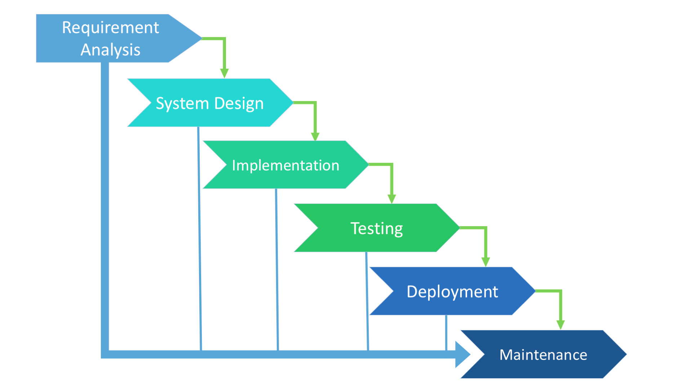
Current Trends In The Market

Slide 8
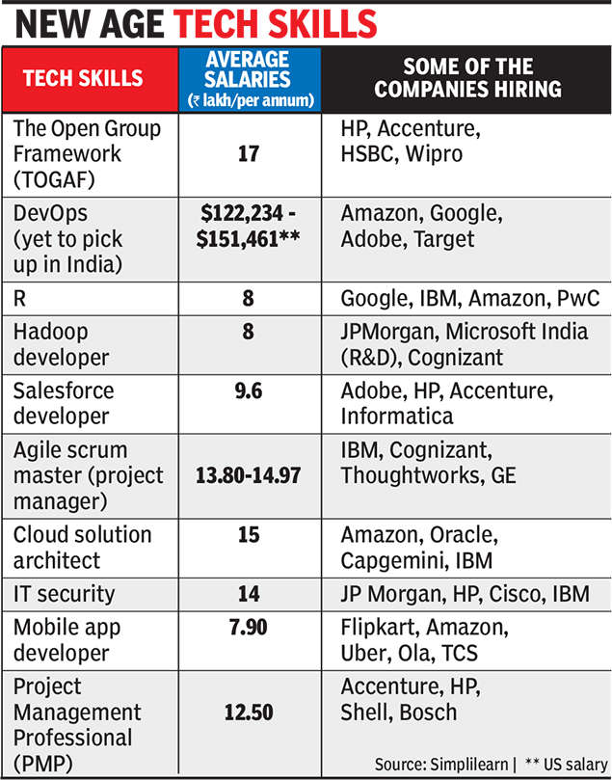
Current Trends In The Market

Slide 9
Current Trends In The Market
Story Time (Oru kadha sollata sir!)
Salesforce In The Organization
Amazon Web Services
The DevOps Pipeline
Full Stack and Mern Stack
The Ultimate Demo

Slide 10
How To Get Ready For Placements???
Target an organization.
Do your homework.
Talk to as many people as you know to get insight about the organization.
Load your mind with the information.
Analyse the information.
Write down the pros and cons.
Ask as many questions as possible.
Get placed with the organization.
NOTE : Before doing the above, read RS Agarwal a million times.

Slide 11
Acing An Interview
We will divide this section into three :
The easy OR tough coding round.
The toughest technical interview.
The easiest HR interview.
The interview that kills you from the inside - My interview experience.

Slide 12
The Easy OR Tough Coding Round - Funny
Depending on whether the invigilator is a nice person or not, you get two options.
Copy the code from the internet provided the invigilator is a nice person and wants the college to get a good name through placements.
Go in the second round, never the first on the condition that the invigilator is a very strict person.

Slide 13
The Easy OR Tough Coding Round - Serious
Be strong with the basics irrespective of which programming language you are good at.
Know what is object oriented programming and know how to code in Java/C#/C++,Python.
Be strong in data structures - Array, ArrayList, LinkedList, HashMap, Set, Queue and Stack.
Think straight and don’t look to the sides even if they serve food.
Know the 1 step solution rather than the 10 step solution to save time.

Slide 14
The Toughest Technical Interview
Before going into the technical round, understand and rethink your past, your family situation, from where you have come, the hard work that you put in and the sacrifices that your parents have made - The above thoughts are the biggest motivators in life.
Be professional. - Body language and eye contact.
Confidence comes in two flavours.
Communicate in english.
Understand the technical scenarios explained to you.
Don’t let out too much of information.

Slide 15
The Easiest HR Interview - Funny
We are all under the impression that the HR interviewer is a very nice person and can be easily convinced to get a job with that organization.
We think that we can get questions such as the following :
What is your native place?
How many brothers and sisters do you have?
What is your brother or sister doing?
How is life?

Slide 16
The Easiest HR Interview - Serious
If you have seriously thought about your life, go back to the career focus slide and answer all those questions. Then the HR interview will be the most easiest interview in your life.
TIPS and TRICKS!
Attitude.
Confidence.
Positivity.
Decision making.
Body language.
Goal oriented.
Now it is time for my interview experience!!!
Did I do all of the above mentioned? - Yes! Yes! Yes!

Slide 17
How do you sort an ArrayList?
How do you find the second maximum salary in a table of 100 rows?
How do you order a Set?
By default, what access modifiers are placed on variables declared within an interface?
How do you do encapsulation in your code?
What is the root interface for all exceptions? What is the superclass for all exceptions?
Can I have a try block without a catch block to handle exceptions?

Slide 18
Q & A

